Slide 1
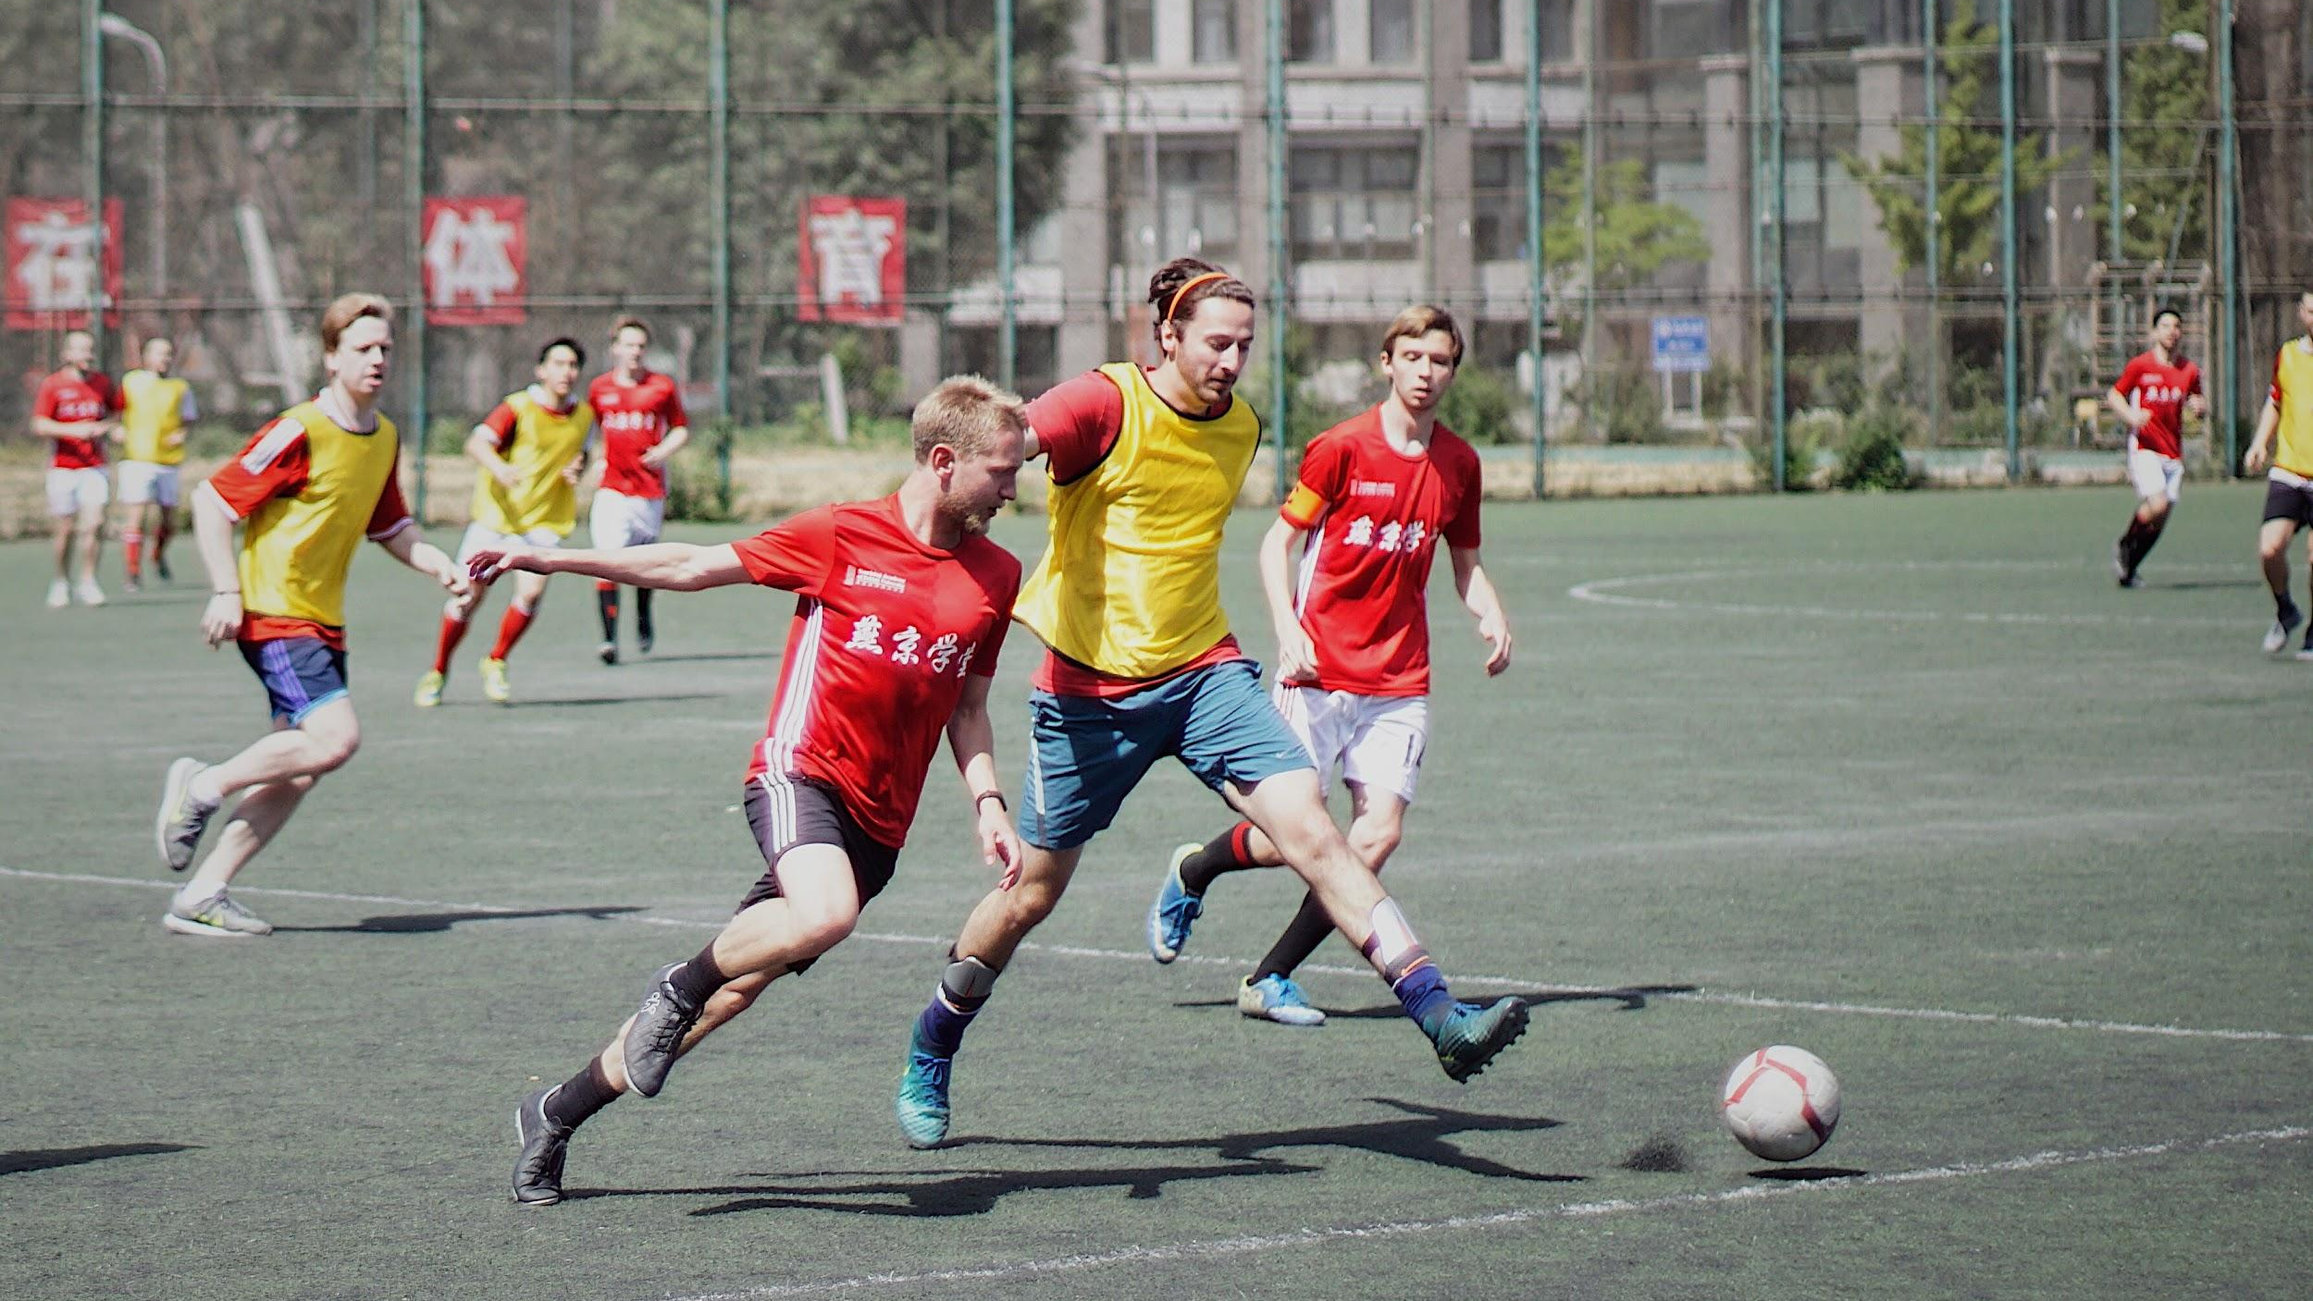
CONTACT & NON-CONTACT FORCES
We will compare contact and non-contact forces.
Notes:
Insert cover image and use transparency settings to fade image.

Slide 2
Do not delete this slide.
This slide is designed so that you can copy the prompt box you need and insert it into your slides.
This slide is hidden and will not be included when presenting your lesson.
TRACK WITH ME
VOCABULARY
1 -
HINT
Students, remember….
CHECK FOR UNDERSTANDING
READ WITH ME
TEACHER CUE
MAKE THE CONNECTION
Students, you already know….
EXTENSION
GESTURE WITH ME

Slide 3

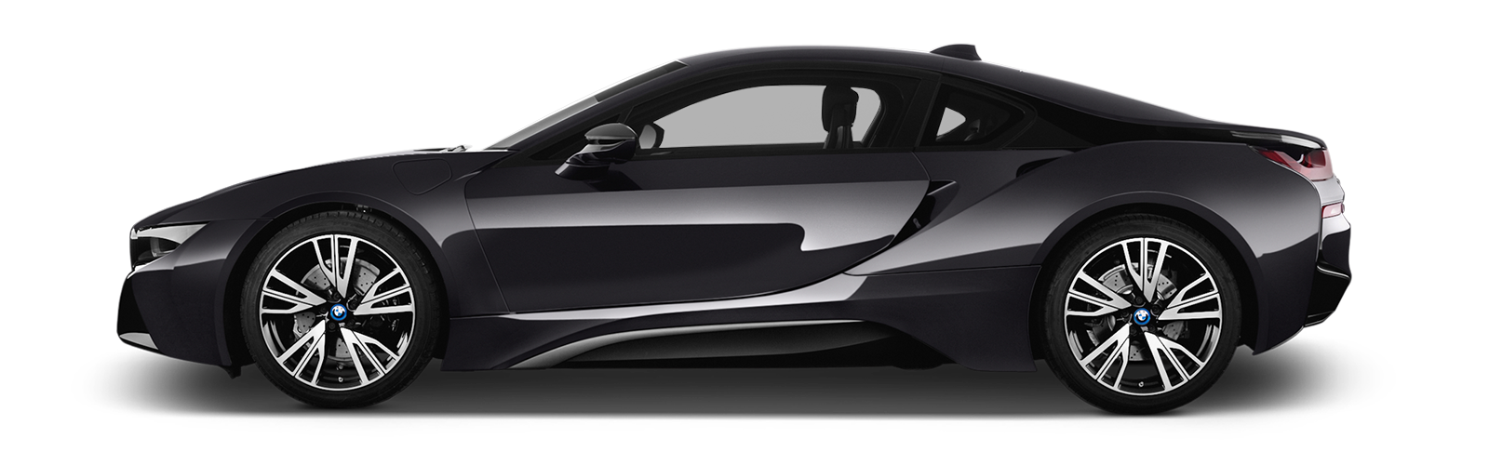
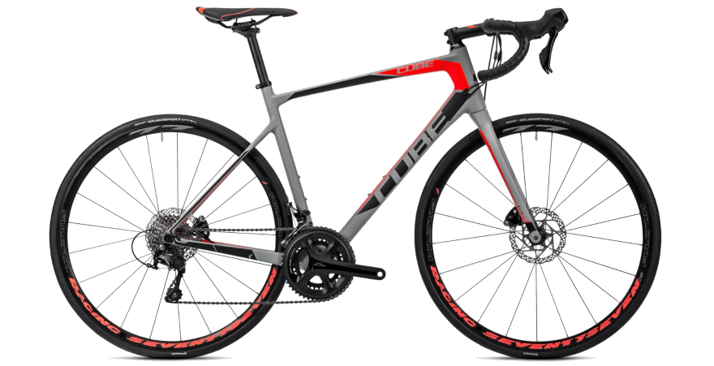
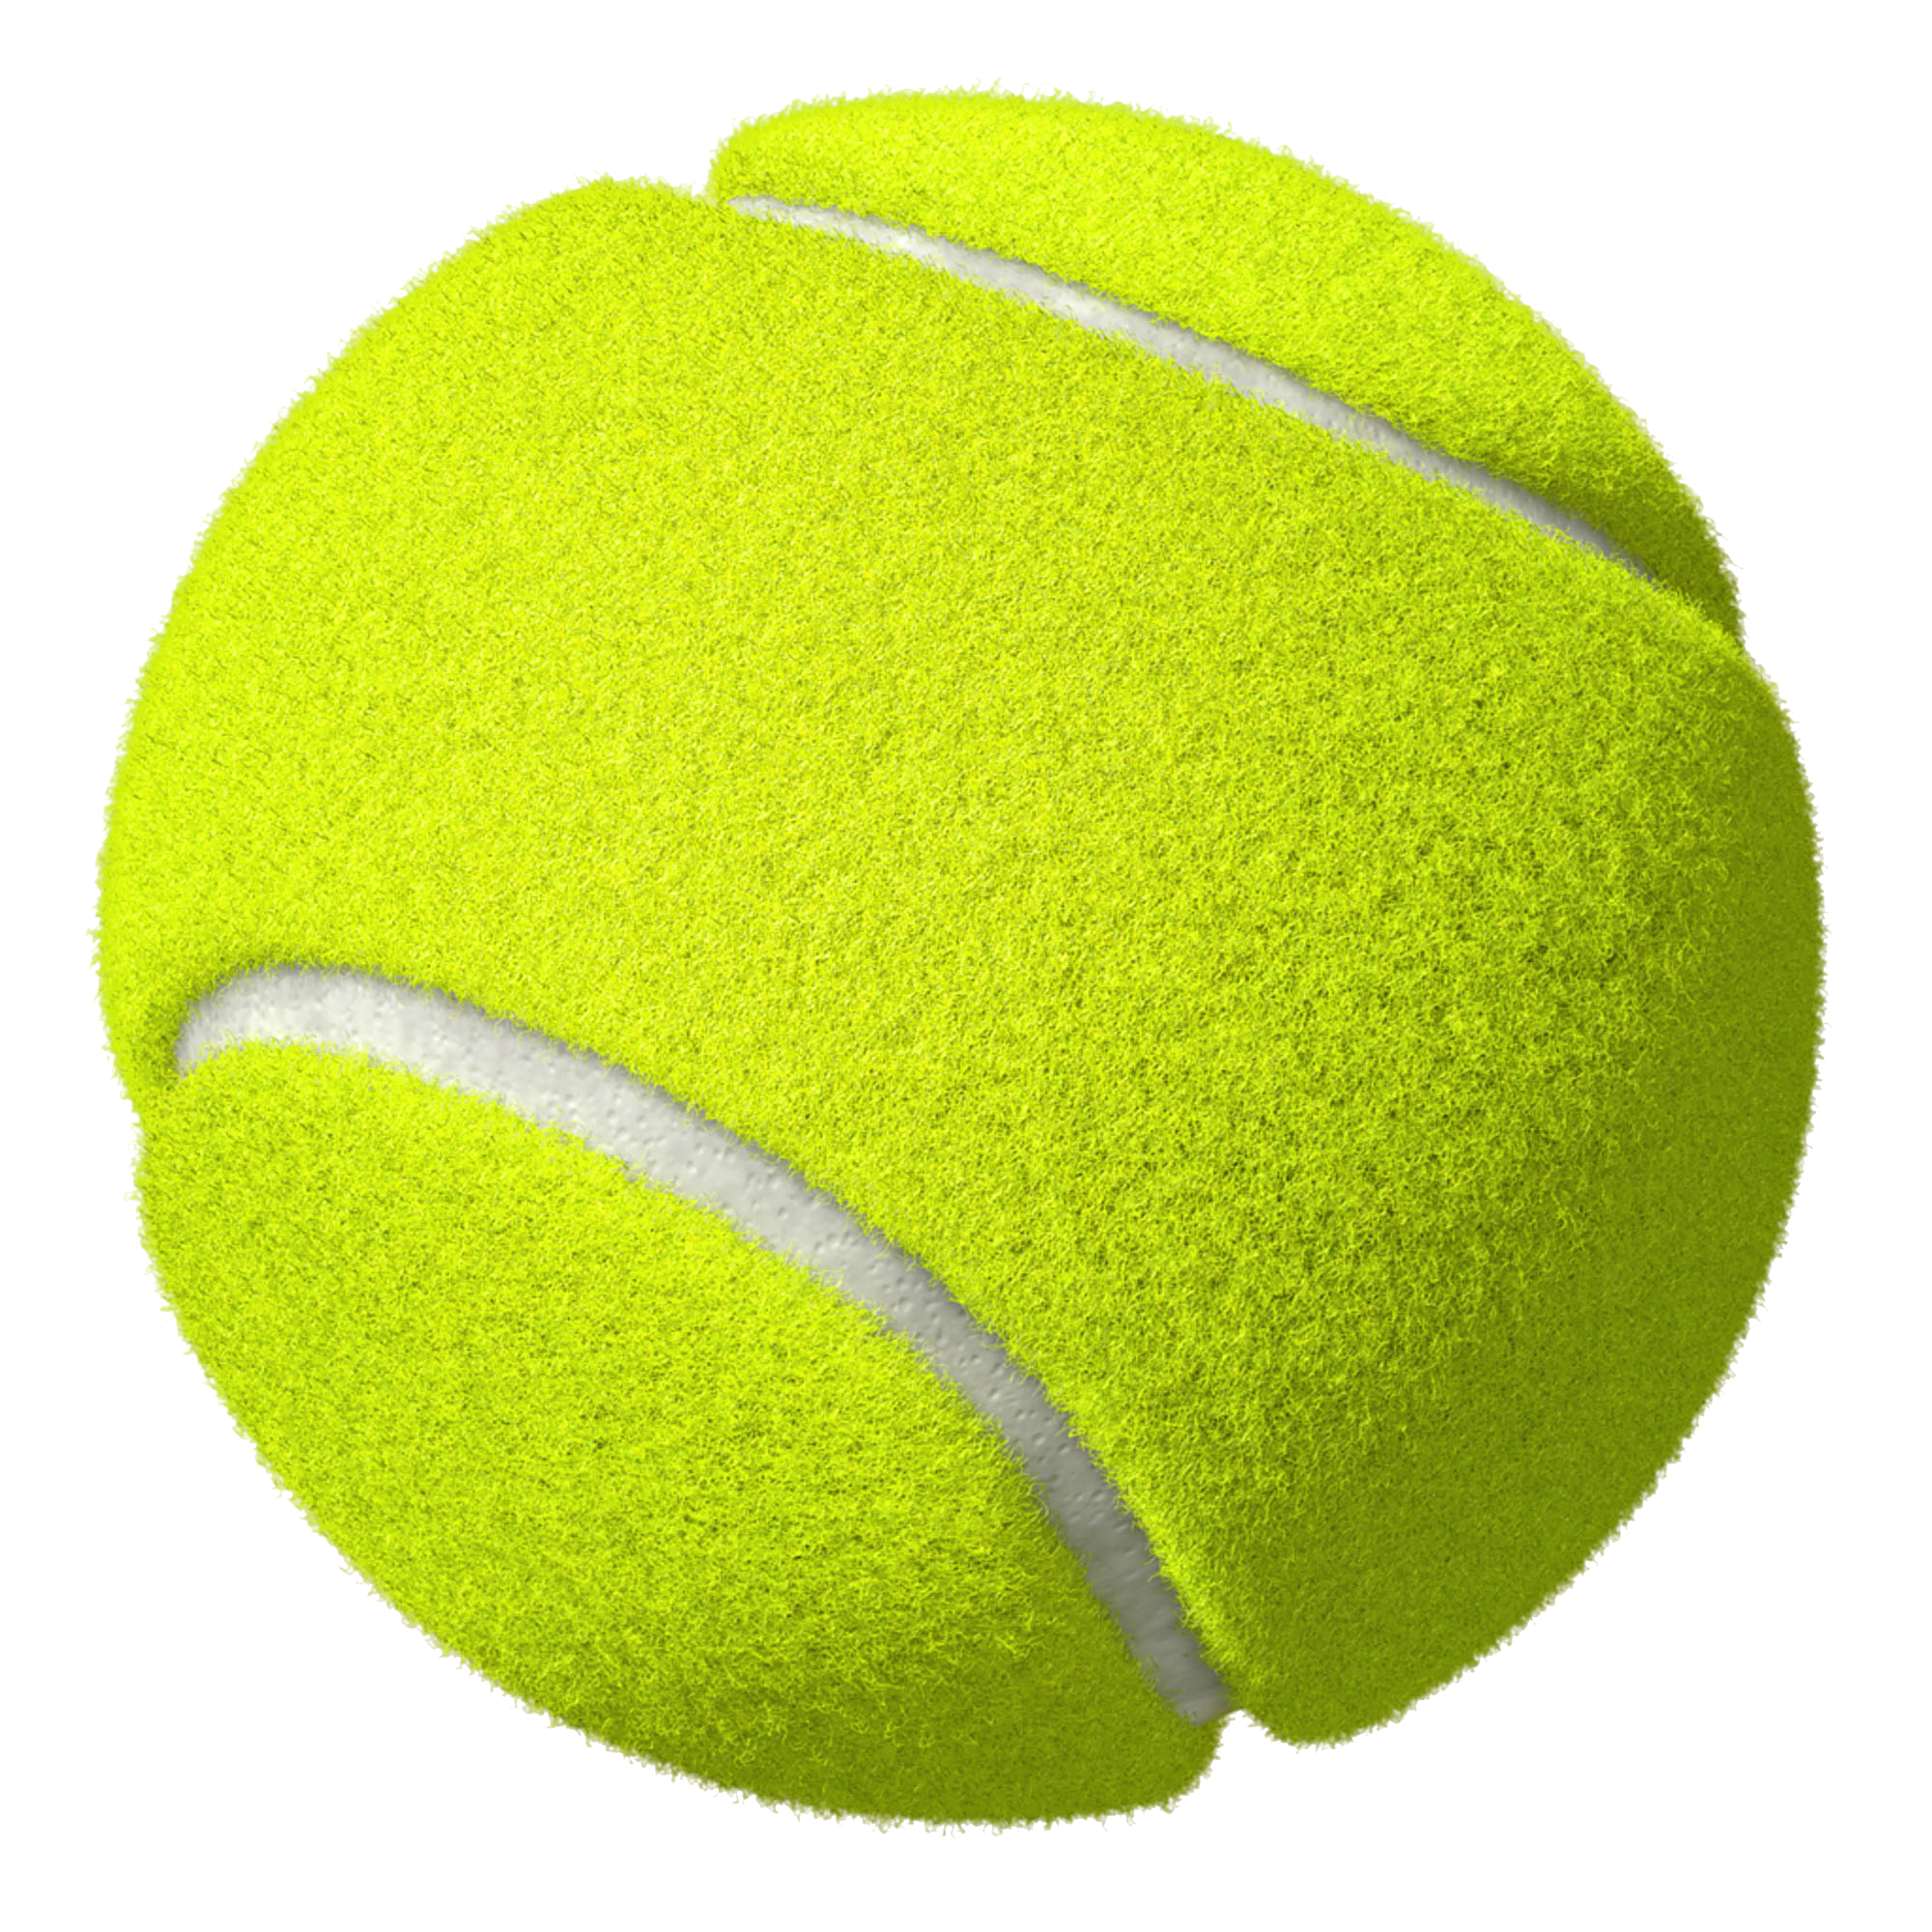
Are these forces balanced or unbalanced? And the direction of their movement?
2.
3.
4.

Slide 4
Repeat the opposite word/phrase.
ATTENTION SIGNAL
GIVE YOUR ATTENTION TO THE TEACHER

Slide 5
Repeat the opposite word/phrase.
FORCE
A PUSH, PULL OR TWIST

Slide 6
Repeat the opposite word/phrase.
NEWTON (N)
UNIT OF MEASUREMENT FOR FORCE

Slide 7
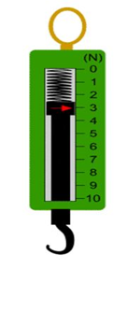
What measurement would this be in newtons?
_____ N

Slide 8
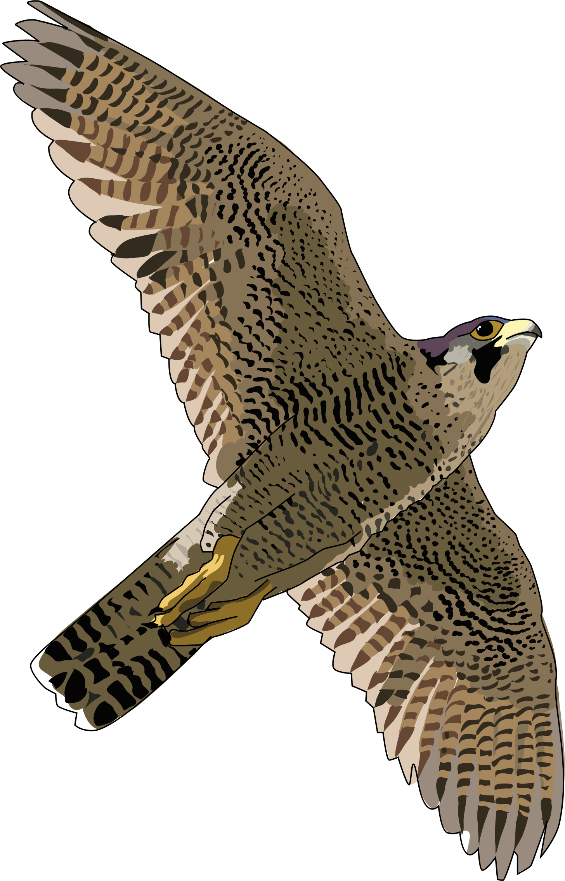
What is the net force of the falcon in the diagram?
150N
450N

Slide 9
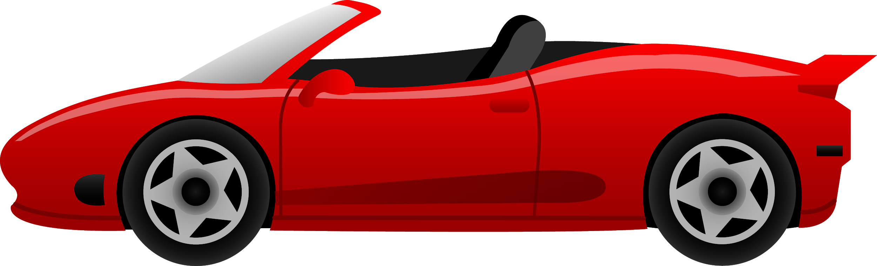
What is the net force in the diagram?
500N
100N

Slide 10
We will compare contact and non-contact forces.
TRACK WITH ME
READ WITH ME
We will define contact force.
We will define non-contact force.
We will explain the difference between contact and non-contact forces.
We will apply contact and non-contact forces to familiar examples.
DECLARE THE OBJECTIVE
Read the learning objective to your partner.
Notes:
Learning Objectives contain concepts (nouns, big ideas), skills (verbs, measurable behaviours) and sometimes context (restricting or targeting conditions).
●Example: Students will be able to describe the concept of density and apply it to floating and sinking.
●
Success criteria are specific measurable outcomes that if met mean that the student has met the learning objective.
Examples:
•Students will be able to compare densities of substances using mass and volume.
•Students will be able to identify whether a solid or liquid will float or sink in a liquid based on their densities.

Slide 11

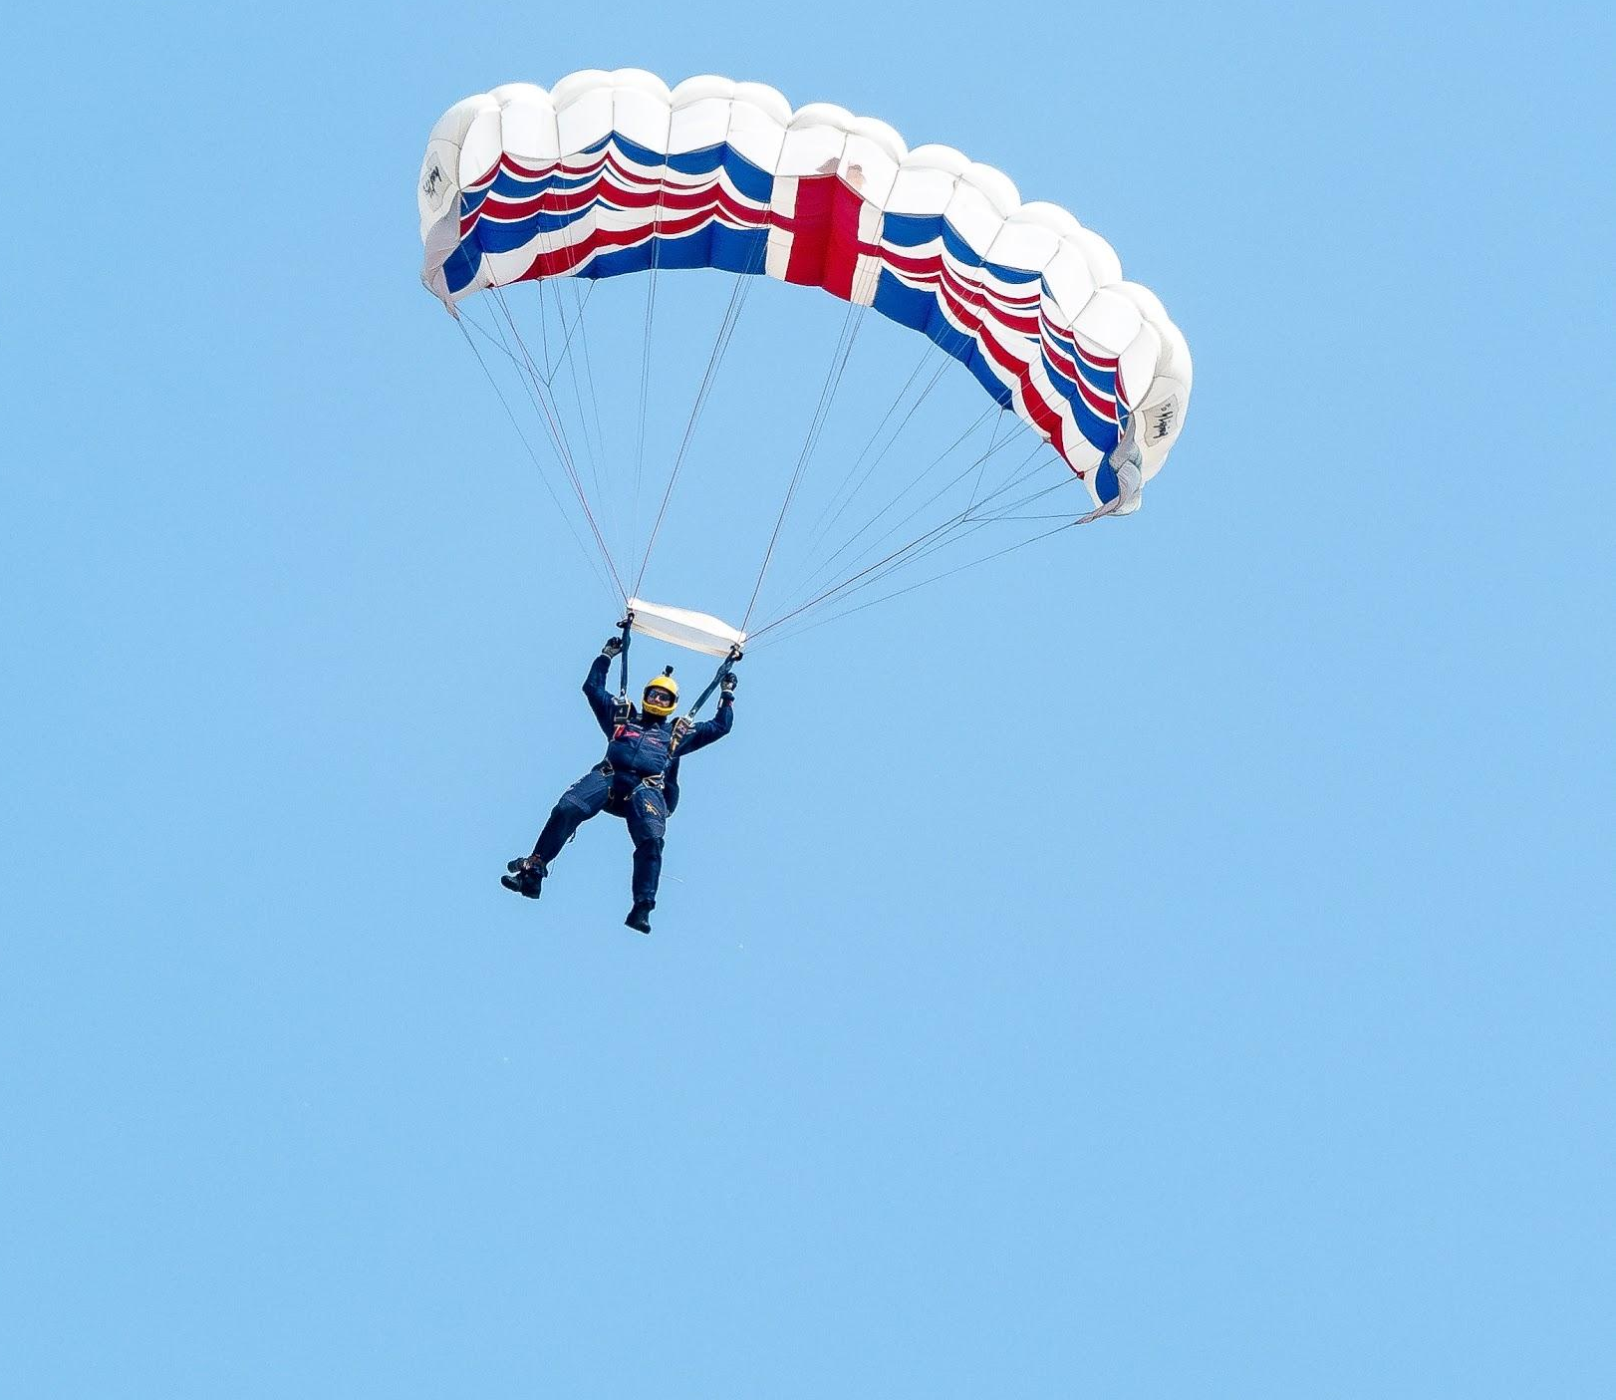

We will compare contact and non-contact forces.
Forces are part of our daily lives as they make things move and stay still.
Pushing and pulling are examples of forces acting to slow things down or speed them up.
What ways can you think of forces acting on an object? Does a force always need to be touching an object to have an effect?

Slide 12
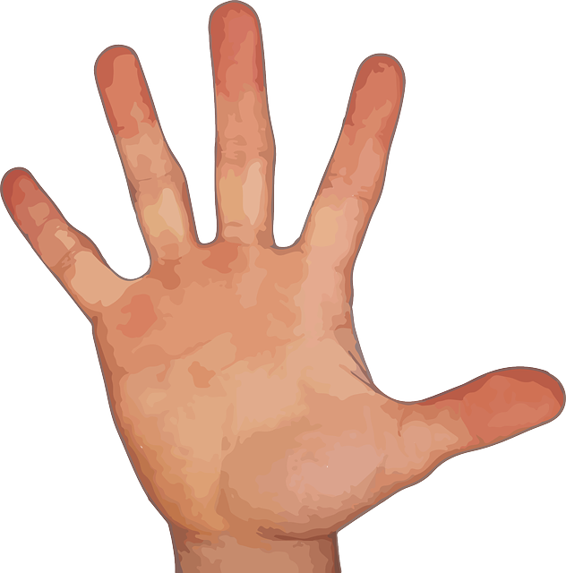
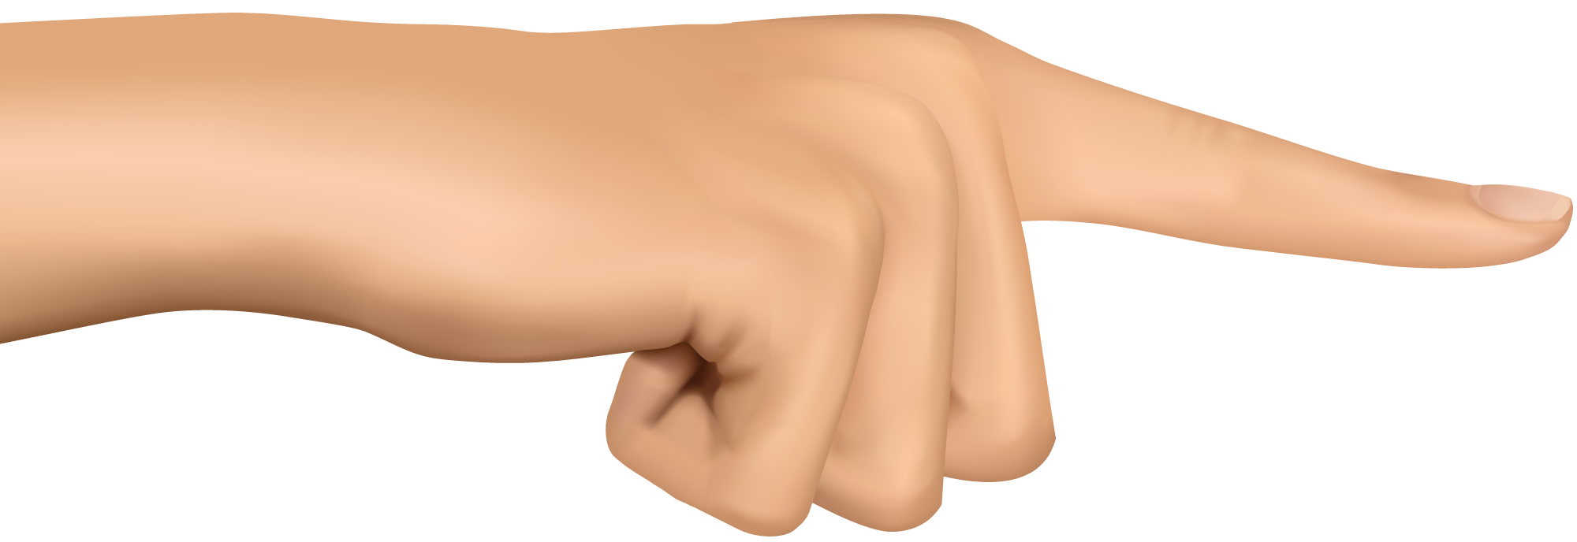

We will compare contact and non-contact forces.
A force is a push, pull or twist created when two objects interact.
All forces (interactions) between objects can be placed into two groups:
Contact₁ forces
Non-contact₂ forces
CHECK FOR UNDERSTANDING
What are the two groups that all forces can be divided into? Is a high-five a contact or non-contact force? Explain your answer.
VOCABULARY
1 - touching 2 - not touching

Slide 13

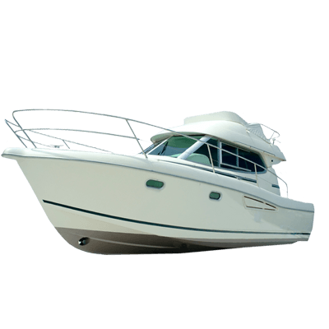
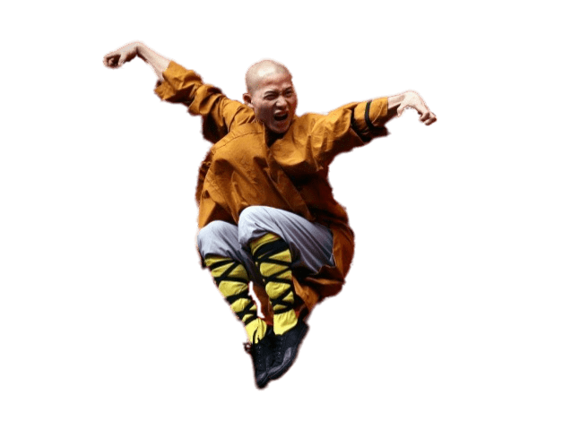
We will compare contact and non-contact forces.
CHECK FOR UNDERSTANDING
What is an example of a contact force acting on an object? Is the person in the picture below floating due to a contact or non-contact force?
Contact forces are forces that result when the two interacting objects are in physical contact₁.
Examples: | Non-examples:
Two objects (e.g. fire-lighting sticks) rubbing against each other. Boats float in water because the water is pushing up against the weight of the boat. | Two magnets being attracted to each other. When you jump in the air and are pulled back towards the ground by gravity.
VOCABULARY
1 - touching

Slide 14

We will compare contact and non-contact forces.
Some forces are able to affect something from a distance. Non-contact forces are forces when the two interacting objects are not in physical contact.
CHECK FOR UNDERSTANDING
What is a non-contact force? What is an example of a non-contact force acting on an object?
Examples: | Non-examples:
Water balloon falling from above someone and gravity pulls it towards the ground. Rubbing hair with a balloon and the hair becomes attracted to the balloon afterwards. | Opening a door with your hand. Trying to run in thigh deep water and are slowing down from the water coming into contact with your legs.

Slide 15
We will compare contact and non-contact forces.
Write the answers on your whiteboard.
Would the following examples involve contact or non-contact forces?
A car using its brakes to slow down.
A skydiver falling towards the Earth.
A basketballer making a slam-dunk.
Making water bend using a rod without the rod touching the water.
A tin can being attracted to a magnet.

Slide 16


We will compare contact and non-contact forces.
CHECK FOR UNDERSTANDING
What do contact and non-contact forces have to do with living on Earth?
Understanding forces allows us to understand why something will move or stay still.
For example, the non-contact force of gravity affects our whole planet.
Our better understanding of forces has led to many scientific advancements.
This includes astronomers using their understanding of forces to launch satellites₁, and maintain their movement in space.
VOCABULARY
1 - objects orbiting the Earth or another planet.

Slide 17
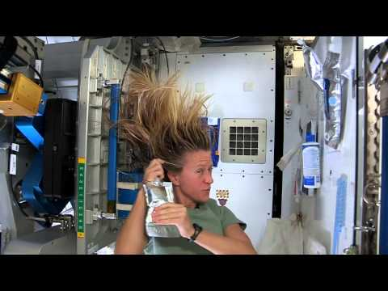
We will compare contact and non-contact forces.
CHECK FOR UNDERSTANDING
List contact forces while watching the video. Why do you think that this astronaut’s hair is floating?

Slide 18
We will compare contact and non-contact forces.
There are two groups of forces, contact and non-contact forces.
Contact forces are forces that result when the two interacting objects are in physical contact.
Non-contact forces are forces when the two interacting objects are not in physical contact.
CHECK FOR UNDERSTANDING
What is the difference between a contact and non-contact force?

Slide 19
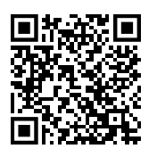
We will compare contact and non-contact forces.
HINT
Contact Forces are forces that result when the two interacting objects are in physical contact. Non-contact forces are forces when the two interacting objects are not in physical contact.
Answer the following questions in your book.
Name an example of contact forces.
Name an example of non-contact forces.
What is the difference between a contact force and a non-contact force?
Why isn’t gravity considered a contact force?
EXTENSION
https://www.bbc.com/bitesize/guides/zyxv97h/revision/1
Notes:
Please include tasks/questions here rather than just referring to a worksheet. This will save on photocopying and facilitate sharing with other schools.
Try and build tasks/questions which escalate through Bloom’s Taxonomy. This will help with differentiation.

Slide 20
We will compare contact and non-contact forces.
We will define contact force.
We will define non-contact force.
We will explain the difference between contact and non-contact forces.
We will apply contact and non-contact forces to familiar examples.
CHECK FOR UNDERSTANDING
Check Success Criteria.

Slide 21





Calculate the net force acting on these blocks to work out which direction they will move.

Slide 22
We will compare contact and non-contact forces.
FRICTION
Whenever an object moves against another object, it feels frictional forces.
BUOYANCY
When an object is put in a fluid (like water), an upward force is exerted by the fluid on the object.
AIR RESISTANCE
Air resistance is caused by the frictional forces of the air
CHECK FOR UNDERSTANDING
VOCABULARY

Slide 23


We will compare contact and non-contact forces.
CHECK FOR UNDERSTANDING
What is a contact force? True or False? A contact force does not need to touch an object to affect it.
Contact forces are forces that result when the two interacting objects are physically contacting₁.
When you kick a ball, you have to touch the ball to put a force on it.
When you go down a hill on a bike, the brakes need to touch the wheel to produce a force called friction so that you can slow down or stop.
VOCABULARY
1 - touching

Slide 24
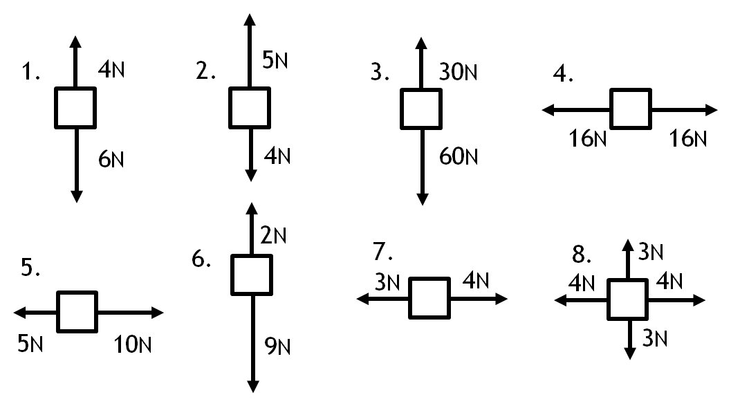
Calculate the net force acting on these blocks to work out which direction they will move.

Slide 25
We will compare contact and non-contact forces.
GRAVITY
All objects have a force that attracts them towards each other. This is called gravity.
Gravitational force increases when: the masses are bigger, AND the objects are closer.
ELECTRO-STATIC FORCE
The attraction between positively charged and negatively charged objects.
MAGNETIC FORCE
The attraction between two magnetic objects.
CHECK FOR UNDERSTANDING
VOCABULARY

